Slide 1




FAIR Data Publishing with Apache Maven
Claus Stadler, Simon Bin, Lorenz Bühmann
Damalos @ ESWC2024
2024-05-26
Supported by
GA No. 01MK21007A
GA No. 9F2266A

Slide 2
Overview
Overall goal: Reproducible way to generate versioned RDF datasets with optional auto-generation of VoID, DCAT, PROV-O metadata and all metadata queryable via SPARQL.
Sections
  Introduction to Maven
  Maven Plugins
  MvnRdfSync
  Querying and Visualization of the RDF dataset metadata

Slide 3

FAIR Data Publishing
Step 1
Step 2
Step 3
RDF Data Catalog
Workflow Specification
Artifacts
DCAT
produces
???
PROV-O
VoID
describes
Fileserver
Artifacts

Slide 4

FAIR Data Publishing with Apache Maven
Step 1
Step 2
Step 3
Maven Repository (Fileserver)
Workflow Specification
(POM)
mvn deploy
Artifacts
Apache Archiva
pom.yaml
describes
GAV
DCAT
plugin declarations
RDF Data Catalog
PROV-O
target repository
VoID
Apache Jena

Slide 5
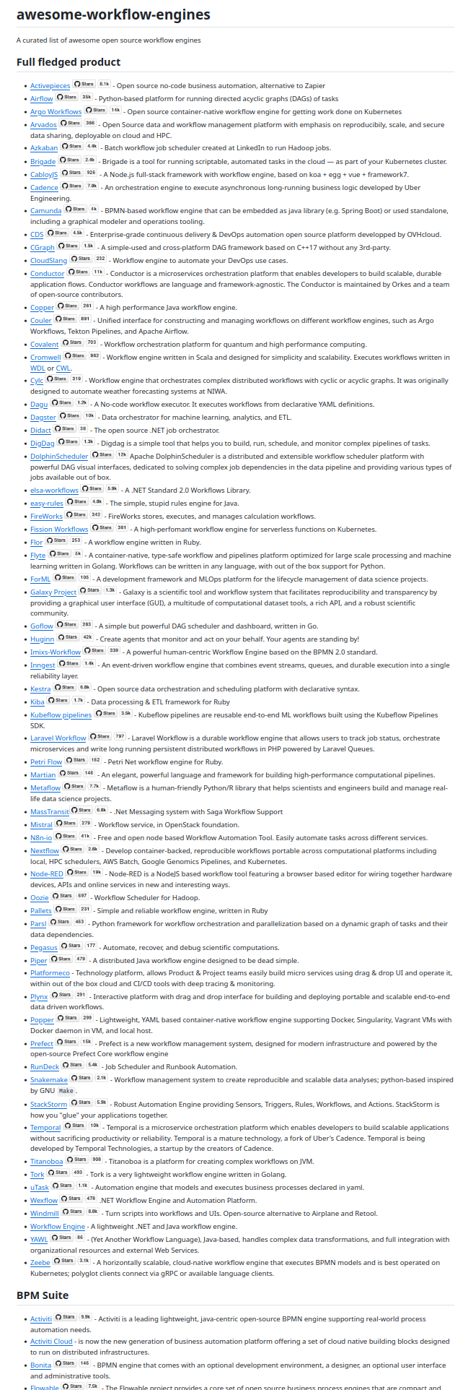
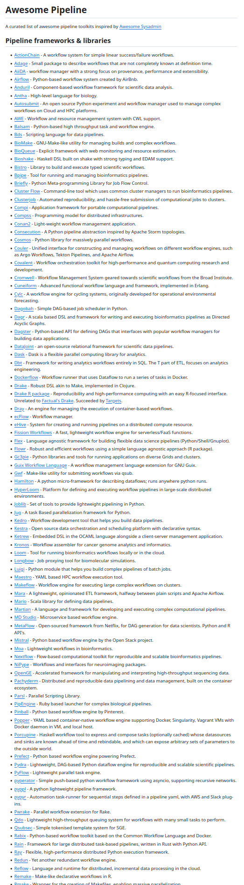
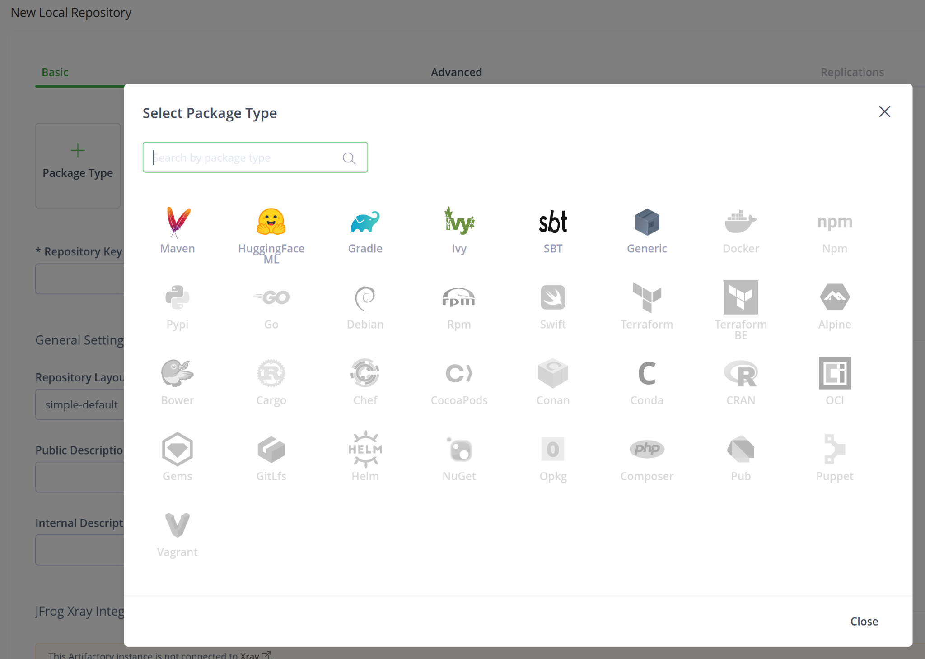
Choices
Artifactory (Artifact Repository Manager)
https://github.com/meirwah/awesome-workflow-engines
https://github.com/pditommaso/awesome-pipeline

Slide 6
Motivation
Sustainable Management of (RDF) Data Assets
  Open Source
  FAIR - Findability, Accessibility, Interoperability, Reuse
  Reproducible (Make it possible to rebuild artifacts)
    We set up a TDB2 triple store for an experiment last year but what data did we load?
    This data was once generated with an RML engine, how long does mapping take today?
    What were the SPARQL queries that we used to generate VoID metadata?

Slide 7
Introduction to Apache
Tool for building projects
  Java, C#, Ruby, Scala, …
First release 2004
  Maven 3 since 2010
  Maven 4 beta since late of 2023
Based on the Project object model (POM)
  An “opinionated” model of a (software) project
  A project consists of phases, in each phase goals can be invoked
  Goals
  Originally XML Syntax, with Polyglot supported Syntaxes are:
    Atom, Groovy, Clojure, Kotlin, Ruby, Scala, YAML, Java
Single-inheritance model
  One POM can declare only one other POM as its parent for inheriting its configuration
  A POM without a parent is implicitly derived from the Super-POM
Can download and deploy artifacts to Maven repositories
  Plugins can “attach” files to a project
Extensible with plugins
  Plugins are artifacts
Global Central Repository
  Preconfigured in the Super-POM
Deploys via HTTPS (and WebDAV still works but deprecated)

Slide 8
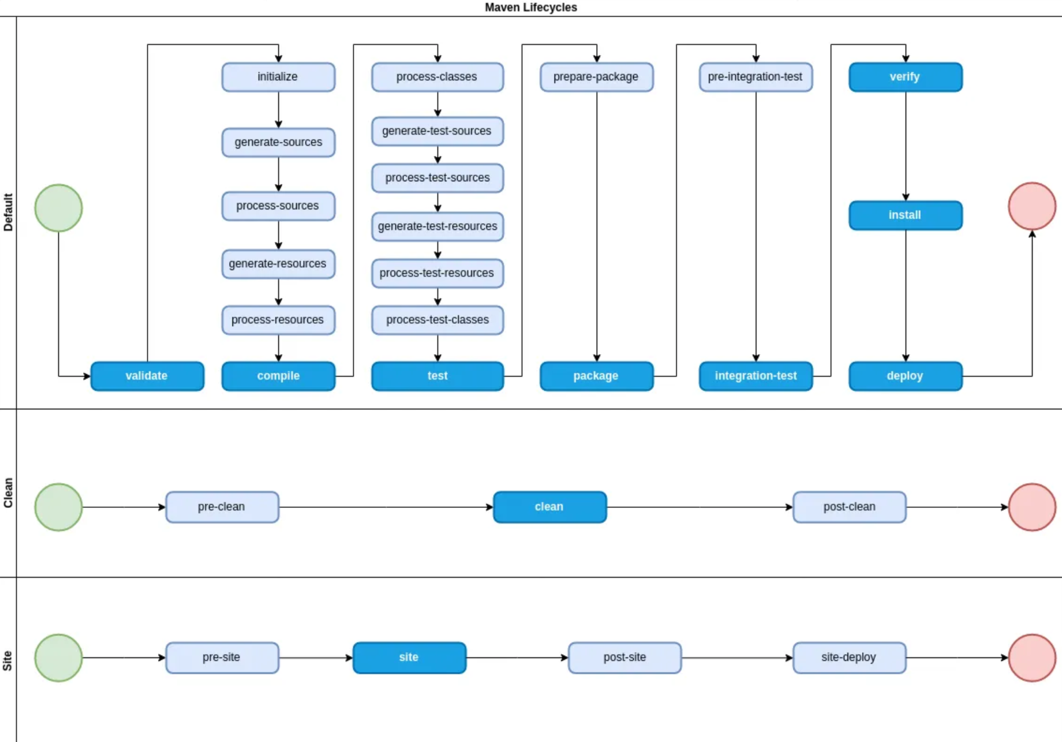
Basic Maven Usage
mvn compile
Compile source files
mvn package
Full build in the project folder
mvn install
Copy artifacts to local repository
mvn deploy
Upload artifacts to remote repository
mvn dependency:tree
Show dependency information
https://medium.com/@yetanothersoftwareengineer/maven-lifecycle-phases-plugins-and-goals-25d8e33fa22

Slide 9
Why Maven?
The POM assigns unique IDs (“coordinates”) to build artifacts
  groupId, artifactId, version
Semantic-Web compatible coordinate system for artifacts
Deployment of a Maven project also deploys the POM
  POMs can be designed to be self-contained
  Re-running such a deployed POM can reproduce the build
Native support for properties and string interpolation
  finalName: “${artifactId}-${profileName}.txt”
Highly configurable with many plugins available
  maven-gpg-plugin, build-helper-maven-plugin
Apache Archiva as a filesystem-based Artifact Repository system
  Easy to backup with rsync
  Easy to trigger changes using inotifywait
  Unfortunately now discontinued - need to find an alternative

Slide 10
Maven and the Semantic Web
Maven Artifacts are identified by “coordinates” (aka GAV)
    groupId:artifactId:version[:type[:classifier]]
  Coordinates are effectively URNs
    Example URN: <urn:mvn:org.springframework:spring-core:6.1.8>
  Filename pattern artifact-version[-classifier].type
    sping-core-6.1.8.jar
  Coordinate URNs translate to relative URLs
    that are appended to the base URL of the repository against which to resolve
    Given a repository base URL and a GAV one can create the (dcat:) download URL

Slide 11
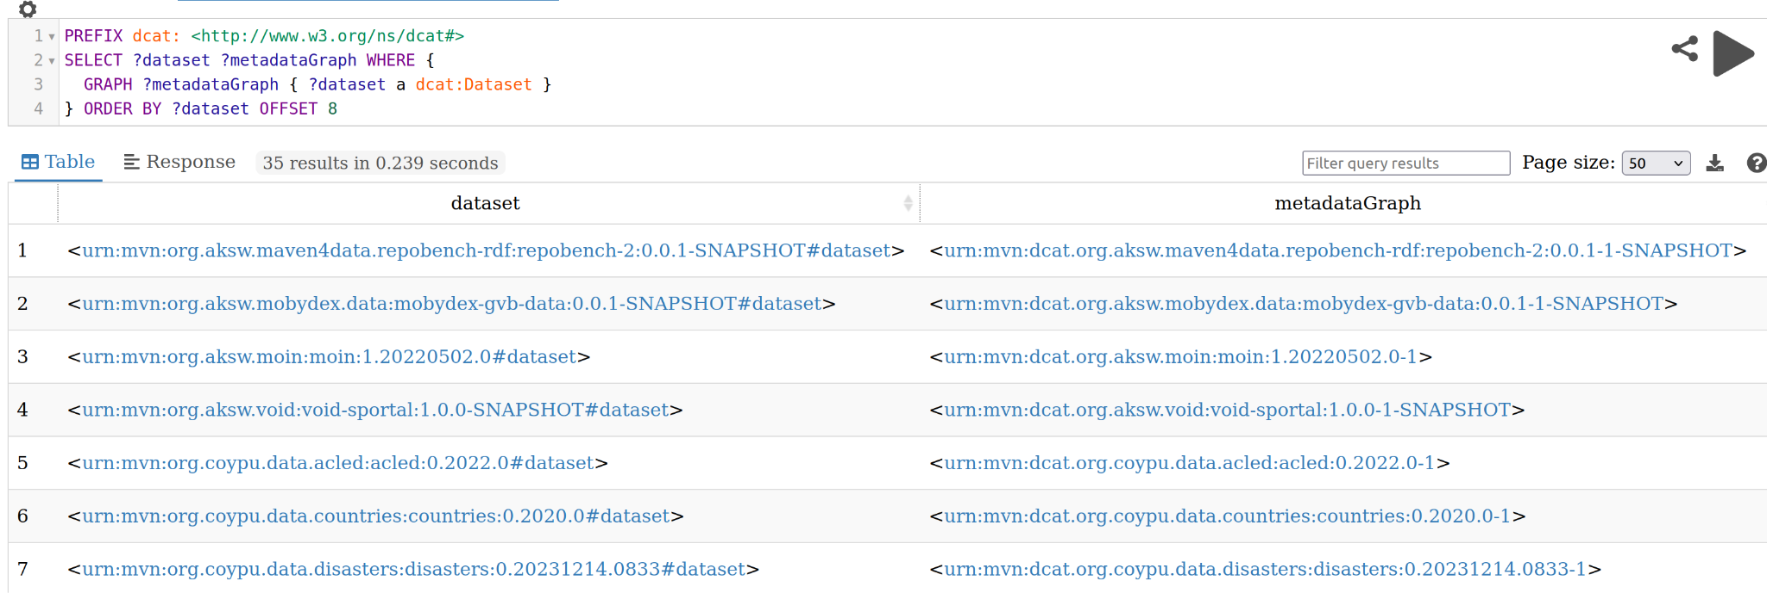
Maven URNs in RDF
Our DCAT RDF based data catalog uses Maven URNs

Slide 12
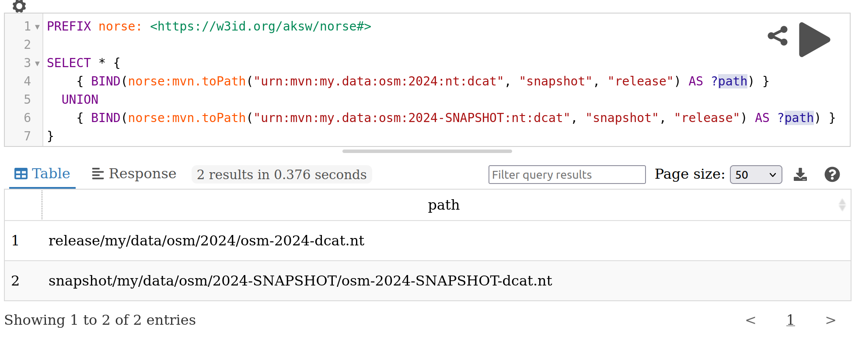
SPARQL Extension Functions
Allows for working with Maven URNs directly in SPARQL
norse = “Not Only RDF” SPARQL Extensions

Slide 13
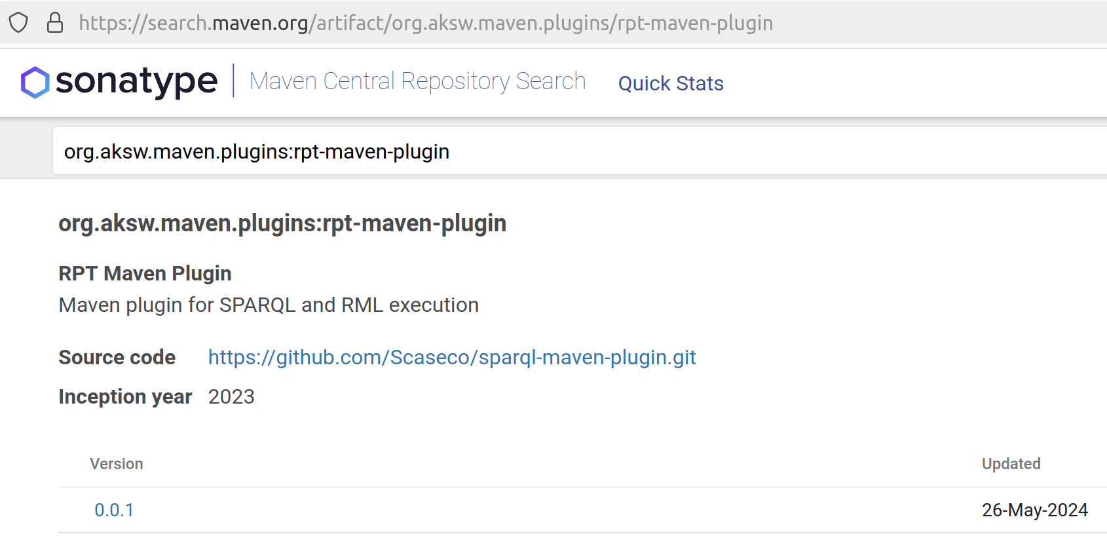
Maven Plugins for specific Problems
We published several Maven plugins (to Maven Central)
  rpt-maven-plugin for running SPARQL queries and RML on RDF files
  ckan-maven-plugin to upload files to CKAN
  tdb2-maven-plugin to create a Apache Jena TDB2 database archives
We started a Website with Information about how Maven and its plugins (not limited to our own) can be utilized effectively
  maven4data: https://scaseco.github.io/maven4data/

Slide 14
Use Case: Versioning of Triplestore Snapshots
modelVersion: 4.0.0
parent:
artifactId: aksw-data-deployment
groupId: org.aksw.data.config
version: 0.0.8
relativePath: ''
groupId: org.aksw.demo
artifactId: my-example-kg
version: 1.0.0
packaging: pom
dependencies:
- {groupId: org.coypu.data.disasters, artifactId: disasters,
version: 0.20240312.1842, type: nt.bz2}
- {groupId: org.aksw.moin, artifactId: moin,
version: 1.20220502.0, type: ttl.bz2}
build:
plugins:
- groupId: org.aksw.maven.plugins
artifactId: tdb2-maven-plugin
version: 0.0.1
executions:
- goals: [load]
tdb2-maven-plugin searches dependencies
for RDF types such as ttl.bz2
Output is a tdb2.tar.gz file with the TDB2 database
“mvn deploy” uploads POM and tdb2.tar.gz
Can be served with Apache Jena

Slide 15
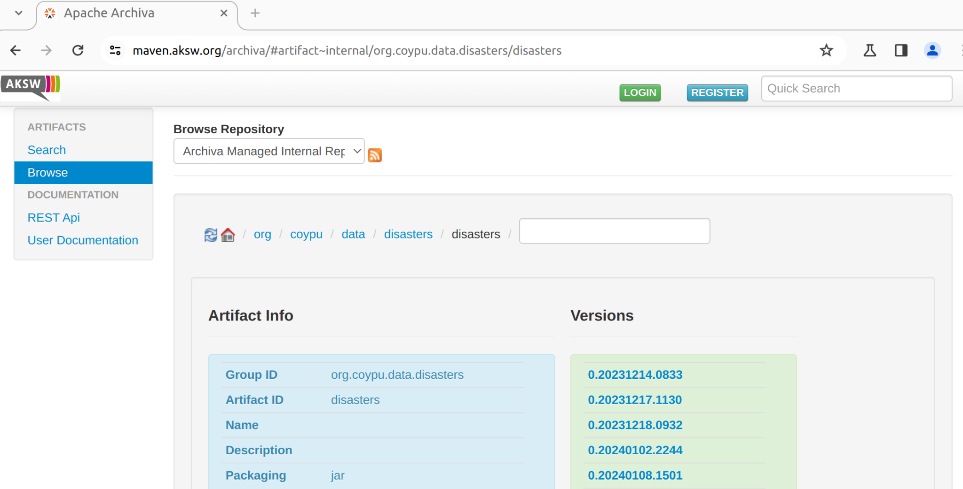
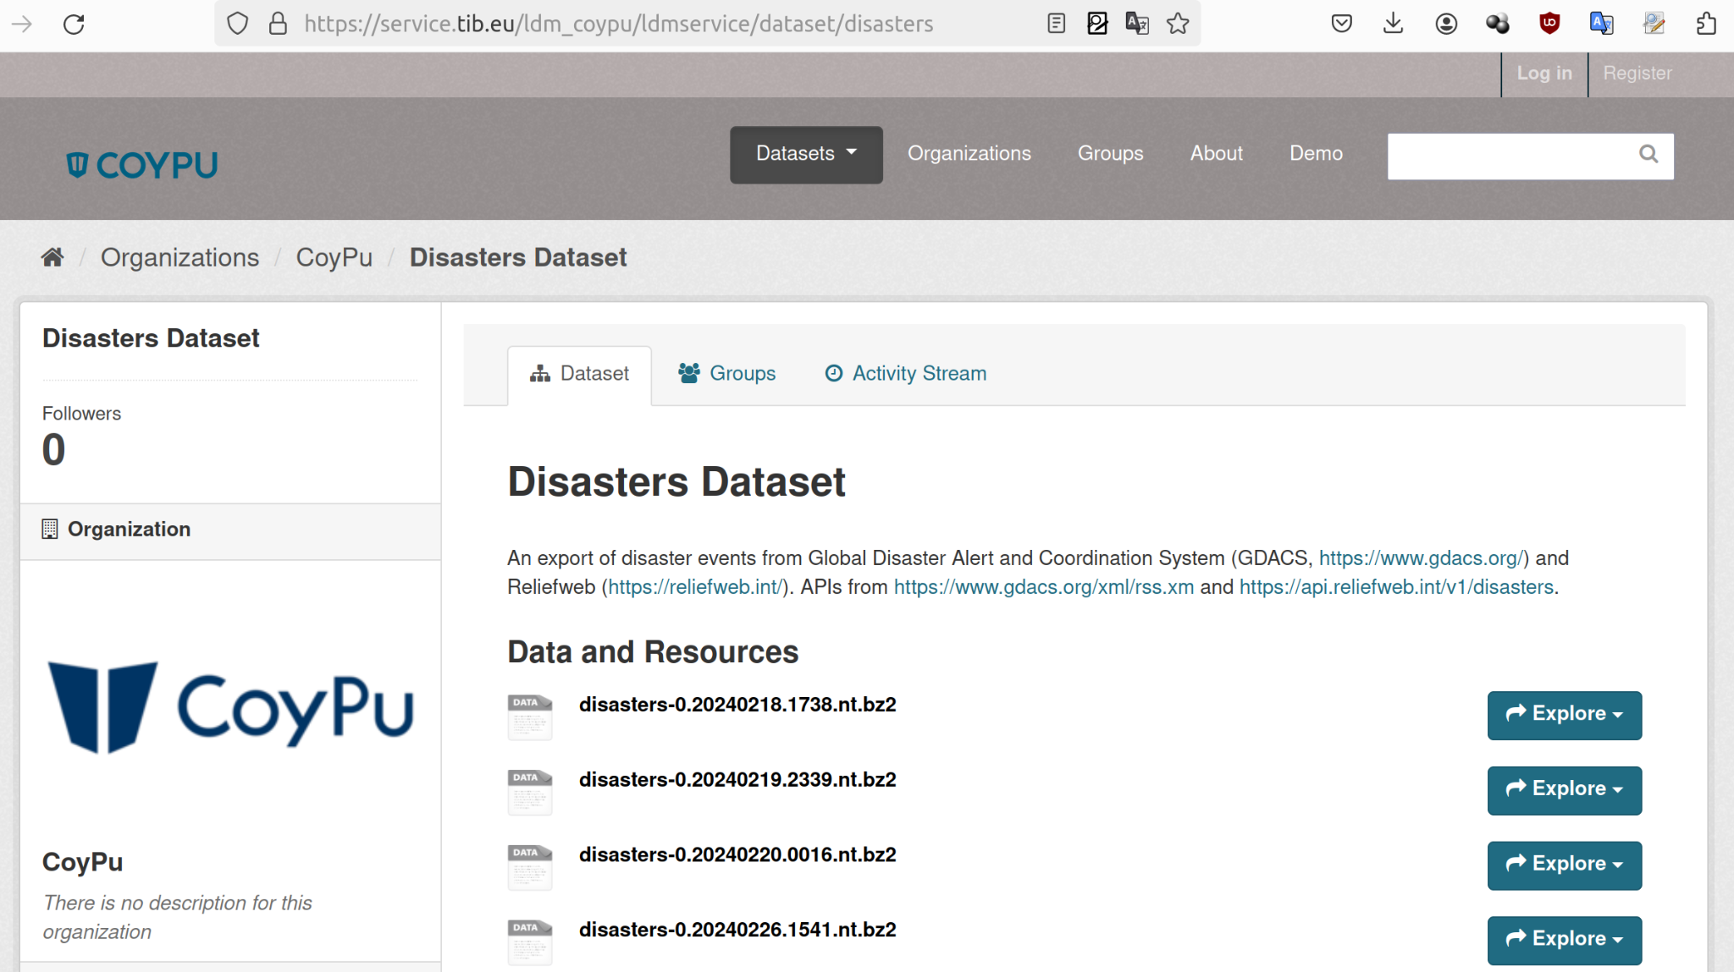
Use Case: Upload to CKAN
- build:
plugins:
- groupId: org.aksw.maven.plugins
artifactId: ckan-maven-plugin
version: 0.0.1
executions:
- configuration:
ckanUrl: 'https://service.tib.eu/ldm_coypu/ldmservice/'
serverId: dm.coypu.org
datasetId: Disasters
uploadPath: '${output.path}'
resourceId: '${output.id}'
resourceName: '${output.id}'
resourceFormat: '${output.filetype}'
downloadFileName: '${output.id}'
organizationId: coypu
author: John Doe
goals: [upload]
id: ckan-upload
phase: deploy

Slide 16
Use Case: Running docker containers within a Maven build
docker-maven-plugin
  Very configurable
  Wait and Timeout conditions to prevent builds from hanging indefinitely
  Support for copying/mounting files into the container and copying files out again
  build-helper-maven-plugin can be used to attach files generated by the container
Experiments
  Created a Maven build that loads a triple store (Virtuoso) from dependencies
  Created a Maven build that starts a dockerized triple store (Fuseki) with a specific configuration and runs queries against it. Build outputs are RDF files with benchmark results.

Slide 17
Use Case: DCAT/VoID/PROV-O Metadata generation
modelVersion: 4.0.0
parent:
artifactId: dcat-generator
groupId: org.aksw.data.config
relativePath: ''
version: 0.0.1-SNAPSHOT
groupId: dcat.org.coypu.data.disasters
artifactId: disasters
version: 0.20240522.1236-1
packaging: pom
properties:
input.groupId: org.coypu.data.disasters
input.artifactId: disasters
input.type: nt.bz2
input.version: 0.20240522.1236
Parent POM encapsulates
DCAT generation
Child POM configures
input for the parent and
produces the output artifact

Slide 18
FAIR Data Publishing with Apache Maven
Step 1
Step 2
Step 3
Maven Repository (Fileserver)
Workflow Specification
(POM)
mvn deploy
Artifacts
describes
DCAT
RDF Data Catalog
PROV-O
VoID

Slide 19
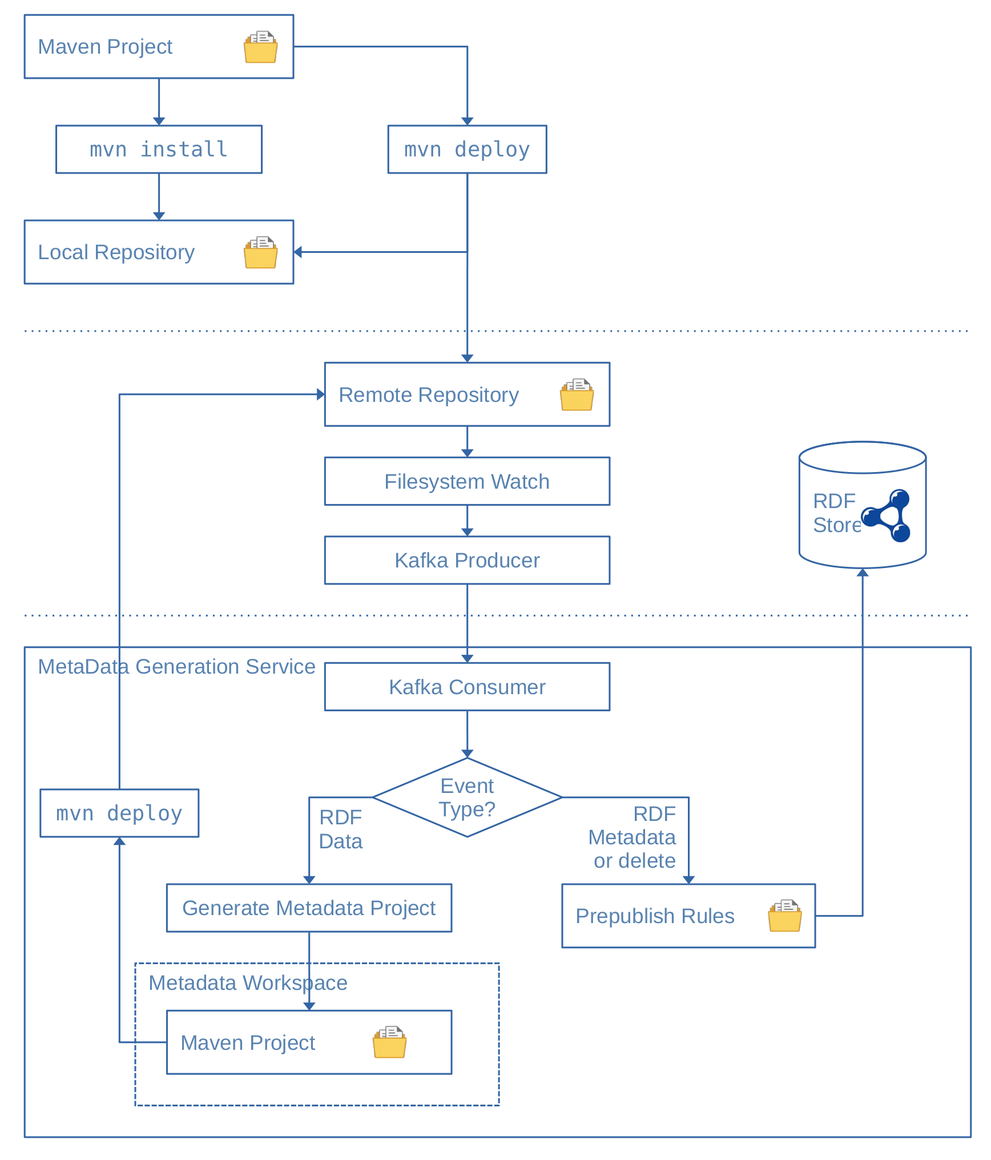
Mvn-RDF-Sync
Synchronize a Triple Store
with Maven Repository
Content

Slide 20
Mvn-RDF-Sync
Synchronize a Triple Store
with Maven Repository
Content

Slide 21
Mvn-RDF-Sync
Synchronize a Triple Store
with Maven Repository
Content

Slide 22
Mvn-RDF-Sync
Synchronize a Triple Store
with Maven Repository
Content

Slide 23
Mvn-RDF-Sync
Synchronize a Triple Store
with Maven Repository
Content

Slide 24
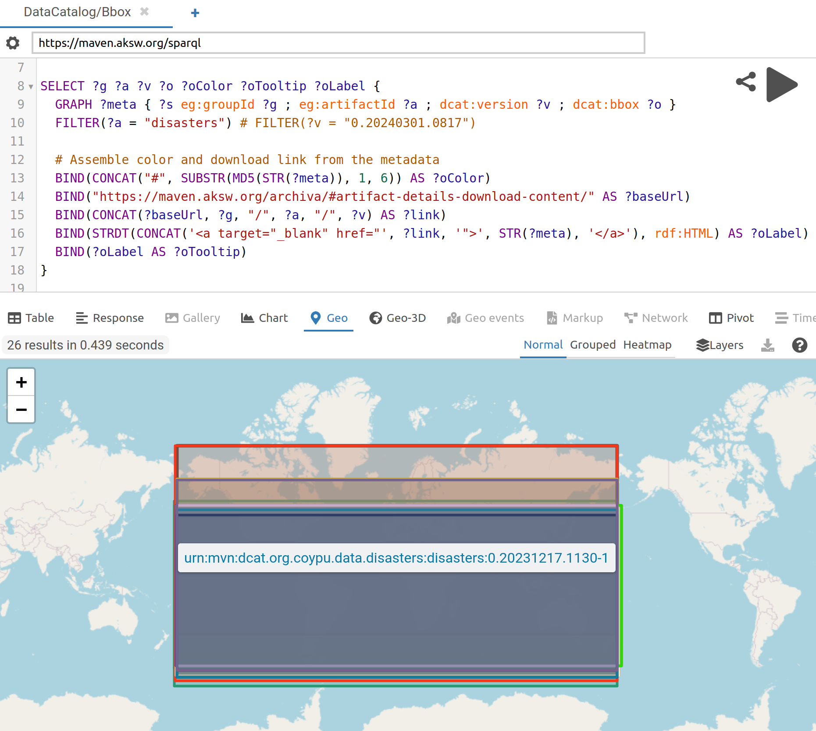
Querying and Visualization
of Data Catalog Content
with Yasgui
Generated BBoxes

Slide 25
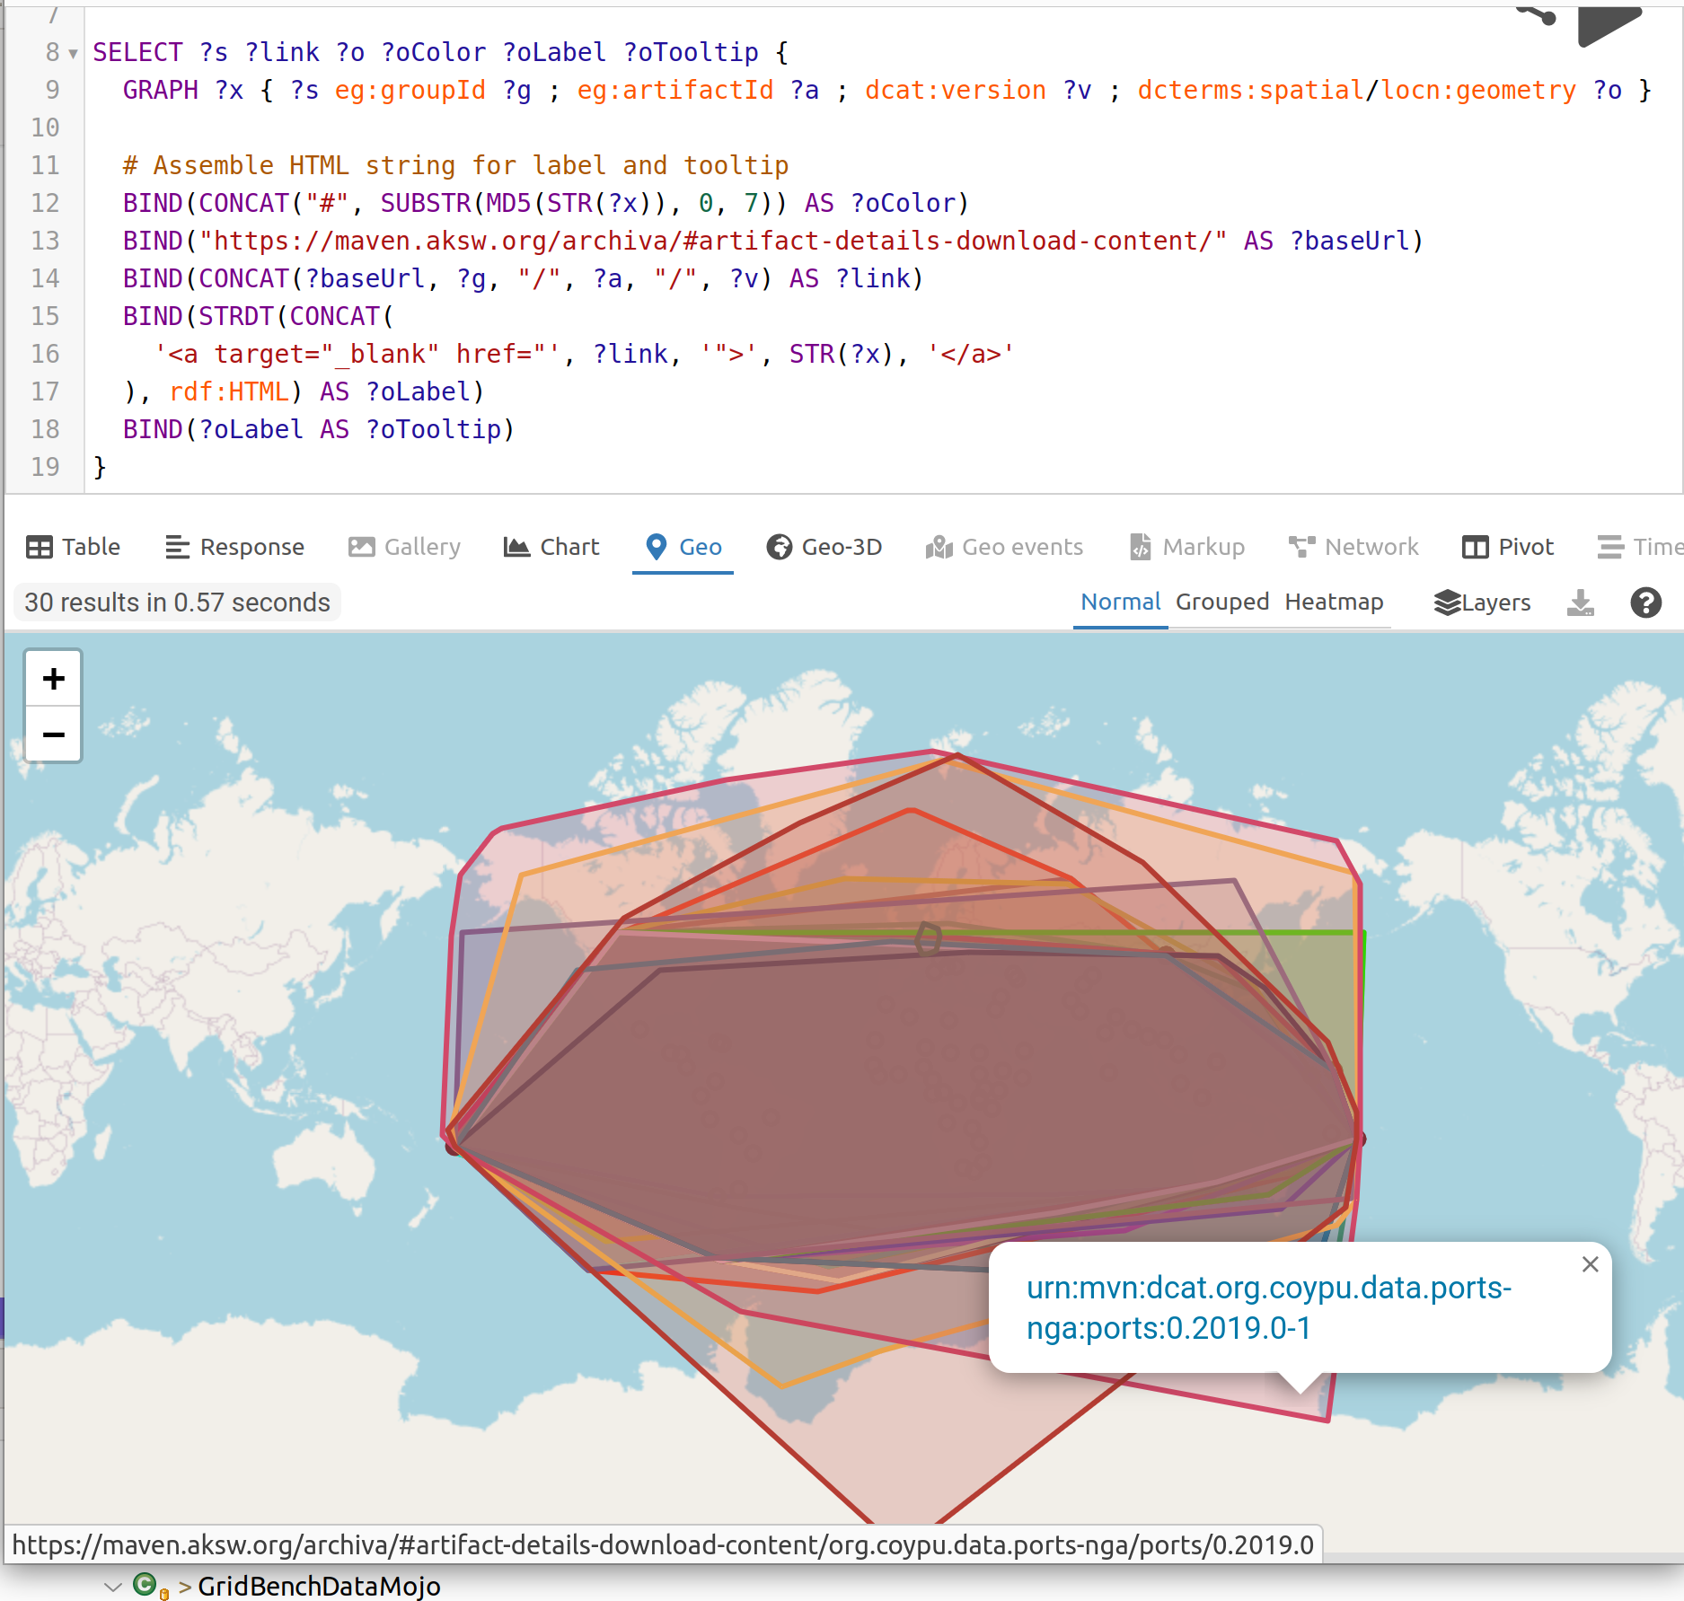
Querying and Visualization
of Data Catalog Content
with Yasgui
Generated convex hulls

Slide 26
Features of a MvnRdfSync Data Catalog
POMs and Artifacts are linked via download URLs
  Maven URN -> URL
POMs that are self-contained can be downloaded and run locally again
  Whether the output of a run is equivalent to deployed data depends on the POM design
Catalog contains VoID, DCAT, PROV
  Metadata generation (VoID, DCAT, PROV) are Maven projects with a reproducible POM
  Current rule: Every artifact with a “dcat” classifier is loaded into the triple store.
Access control is orthogonal
  The one who deploys needs to supply the maven build process with e.g. the API keys
  The repository system needs to handle it

Slide 27
Future Work
Interoperability of Maven and SOLID pods
  Maven can read/write to WebDAV, could a pod directly act directly as a deploy target for Maven and can we read from or would that require a plugin similar to CKAN?
More plugins to deploy to popular repositories
  zenodo-maven-plugin (huggingface, …)
  Maybe someone gets inspired and wants to build it :)
CWL and Maven
  Would it make sense to have support in CWL to execute maven plugin goals?
  (Reuse rather than rebuild)

Slide 28

Thank You! Questions?
Claus Stadler cstadler@informatik.uni-leipzig.de
Maven4Data Website
  ckan-maven-plugin – Upload artifacts to CKAN
  rpt-maven-plugin – Execute SPARQL queries and RML
  tdb2-maven-plugin – Create TDB2 databases from RDF dependencies
  mvn-rdf-sync – Sync filesystem-based Maven repository with an RDF store
https://scaseco.github.io/maven4data/
For related work: Getting practical with GeoSPARQL and Apache Jena
Simon Bin, Claus Stadler, Lorenz Bühmann, and Michael Martin
GeoLD 14:00-15:00
https://github.com/Scaseco/mvn-rdf-sync

